Slide 1



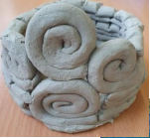
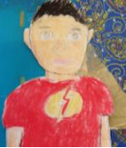
Art
Enrichment
At Leopold Primary School, we enhance our Art curriculum in a variety of creative and inspiring ways. We provide specialist support, where children have lessons taught by confident, skilled teachers, who provide engaging and fulfilling projects for all year groups, who learn about famous artists and craftspeople. We make use of many media in school such as paint, clay, collage, and printing to ensure that our children get the most from our Art curriculum..
Leopold Primary School follows the Kapow website to deliver an engaging and meaningful curriculum. Leopold supports children in further creativity in Art using digital technology on websites such as Purple Mash which students can use to create wonderful works of art saved to their drive for teachers to see.
At Leopold Primary School, pupils use our innovative technology to support them with their learning, be it for research or taking pictures of their learning

