Slide 1
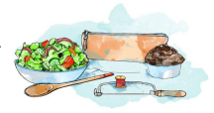


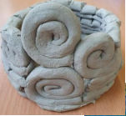
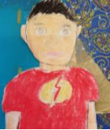
Design & Technology
Enrichment
At Leopold Primary School, we enhance our Design & Technology curriculum in a variety of engaging and interesting ways. We provide specialist support, where children have lessons taught by confident, skilled teachers, who provide projects that offer the children to learn valuable skills in all year groups. We focus on a range of topics such as food, structures, and mechanisms to ensure that our children get the most from our Design & technology curriculum.
Leopold Primary School follows the Kapow website to deliver an engaging and meaningful curriculum. Leopold supports children in further creativity in Design & Technology by using digital technology on websites such as Purple Mash which students can use to create wonderful works of design saved to their drive for teachers to see.
At Leopold Primary School, pupils use our innovative technology to support them with their learning, be it for research or taking pictures of their learning

